Slide 1
METRO OVERVIEW
Region’s largest public transportation agency
Metro operates:
Fixed-route bus service, paratransit, vanpool, water taxi, Dial-A-Ride-Transit, flexible transit services
Link light rail and ST Express bus (under contract to Sound Transit)
Seattle Streetcar (under contract to City of Seattle)
$3.1 billion biennial budget (operating & capital)
Pre-pandemic, 4 million service hours, 120 million riders (~500,000 weekday boardings)
Today, operating 87% of service for 60% of riders

Slide 2
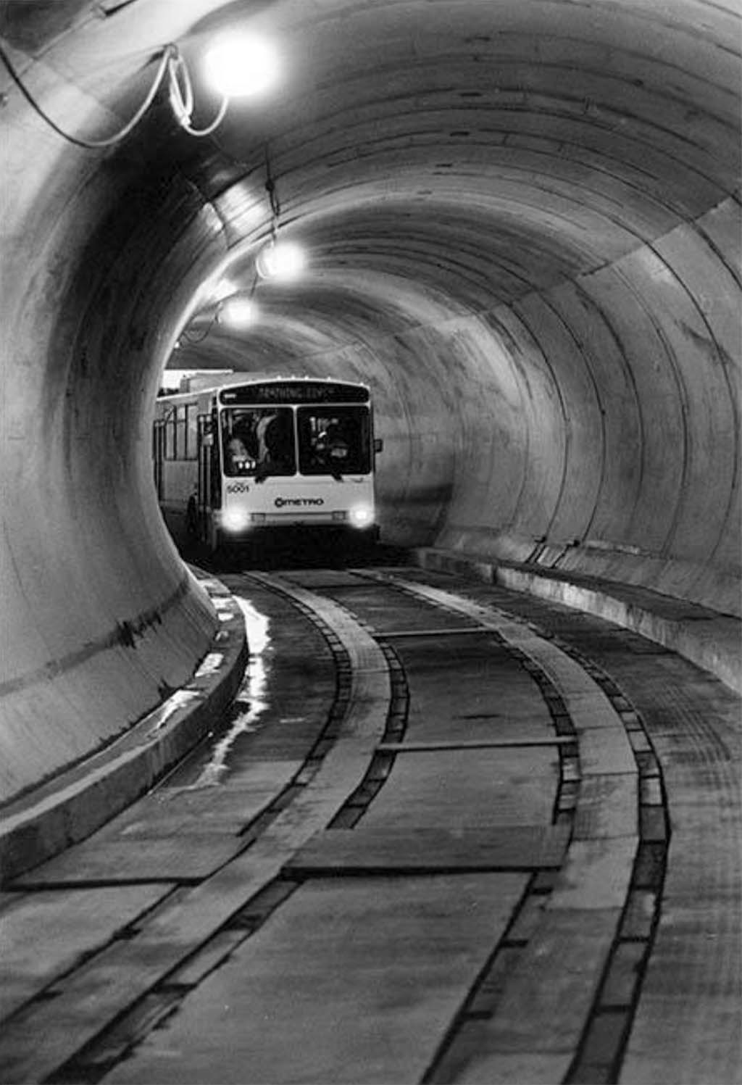
METRO GOVERNANCE
Independent government, Municipality of Metropolitan Seattle (Metro) created in 1950s for wastewater treatment
Metro Transit began in 1973 as part of Metro agency
Metro functions merged into King County in 1990s
Voters changed King County’s Charter to create regional committees to oversee the former Metro functions
Dual governance with King County Council

Slide 3
RTC ROLE
Regional committees established in King County Charter (§270)
Regional Policy Committee (RPC)
Regional Water Quality Committee (RWQC)
Regional Transit Committee (RTC)
RTC role:
“…develop, propose, review and recommend action on ordinances and motions adopting, repealing, or amending transit… countywide policies and plans…” (King County Charter §270.30)

Slide 4
RTC MEMBERSHIP
9 voting members – 12 votes total
DELEGATION | MEMBERS | VOTES EACH | TOTAL VOTES
King County | 3 | 2 | 6
Seattle | 2 | 1 | 2
SCA | 8* | 1/2 | 4
*Note: “Other cities and towns” (represented by SCA) have 4 voting members (and 4 votes) on the RTC. The SCA has chosen to allocate those votes among 8 people, with each person casting ½ vote. (King County Code 1.24.065.B.1.a, Rule 7)
Chair is a King County Councilmember, chosen by the Council Vice Chair is a non-County member, elected by non-County RTC members

Slide 5
METRO OVERSIGHT
King County Council oversees:
Metro’s biennial budget and financial management
Metro’s operations (including transit service changes)
Regional Transit Committee (RTC) and King County Council oversee:
Development, adoption of Metro’s “countywide policies and plans” (three adopted policy documents)
Monitoring the implementation of “countywide policies and plans”
Note that if a funding measure is to be proposed to voters, it would be developed either by the King County Council (with RTC) or by the King County Transportation District (separate government made up of all 9 County Council members)

Slide 6
ADOPTED TRANSIT POLICIES
Updated by Ordinance 19367 (December 2021)
Strategic Plan for Public Transportation
Outlines Metro’s goals, objectives, strategies, performance measures
10 goals, performance measures for each goal
Service Guidelines
Set targets for the level of transit service
Provide criteria to develop, modify, and evaluate transit service
Metro Connects
Metro’s long-range plan
Plans for growth in transit service through 2050
Not fully funded

Slide 7
STRATEGIC PLAN OVERVIEW
Ten-year plan (2021-2031)
Metro’s Mission
Provide the best possible public transportation services and improve regional mobility and quality of life in King County
Metro’s Vision
Metro will advance its mission by delivering a regional, innovative, and integrated mobility network that is safe, equitable, and sustainable
Includes goals and performance measures to track progress

Slide 8
STRATEGIC PLAN GOALS
GOAL | DESCRIPTION
Investments | Invest upstream and where needs are greatest
Sustainability | Address the climate crisis and environmental justice
Innovation | Innovate to improve mobility, complement transit, and advance equity and sustainability
Safety | Keep passengers, employees, and communities safe
Transit-Oriented Communities | Support thriving, equitable, transit-oriented communities that foster economic development
Access | Improve access to mobility options
Service Quality | Provide fast, reliability, and integrated mobility services
Workforce | Build a skilled, diverse, and well-supported workforce that has growth opportunities
Stewardship | Be responsible stewards of financial resources
Engagement | Conduct deliberate and transparent community engagement

Slide 9
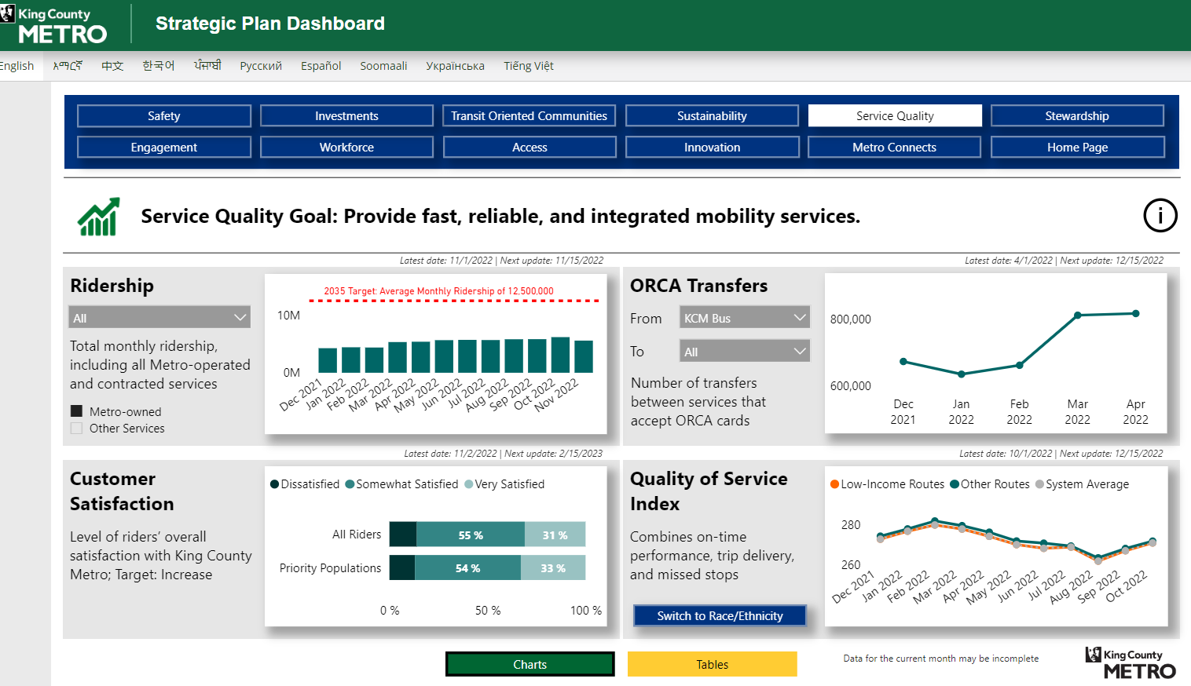
STRATEGIC PLAN PERFORMANCE MEASURES
Metro’s online dashboard tracks performance measures

Slide 10
SERVICE GUIDELINES OVERVIEW
Provide criteria to guide Metro’s daily operations
Develop service. Criteria to plan, space, and organize fixed-route and flexible services
Modify service. Criteria to:
Add service
Reduce service
Restructure service
Evaluate service. Criteria to evaluate route performance and set target service levels

Slide 11
SERVICE GUIDELINES ADDING SERVICE
Updated Guidelines use three priorities to add fixed-route transit service
Priority 1 = Reduce Crowding: add service to overcrowded routes
Priority 2 = Improve Reliability: add service to routes that run late
Priority 3 = Grow Service: fill gap between existing and target service using three factors:
How reach target
What is target
Factors adopted for Priority #3 | Prioritization | Weight
Equity Metrics identify areas with priority populations | 1 | 25%
Land Use Land use density based on # households, P&R stalls, jobs, low-income jobs, students w/in ¼ mile | 2 | 50%
Geographic Value Connections between Centers | 3 | 25%

Slide 12
SERVICE GUIDELINES REDUCING SERVICE
Updated Guidelines use equity and productivity when transit reductions must be made
Least productive and lowest equity routes are the first to be prioritized for reduction
Priority | Proposed Conditions for Order of Service Reduction
1 | Routes in bottom 25% of both productivity measures, with low equity score (score of 1-3)
2 | Routes in bottom 25% of both productivity measures, with high equity score (score of 4-5)
3 | Routes in bottom 25% of one productivity measure, with low equity score (score of 1-3)
4 | Routes in bottom 25% of one productivity measure, with high equity score (score of 4-5)
5 | Routes in bottom 50% of one or both productivity measures, with low equity score (1-3)
6 | Routes in bottom 50% of one or both productivity measures, with high equity score (4-5)

Slide 13
SERVICE GUIDELINES RESTRUCTURING SERVICE
Transit service is restructured for major land use or transportation changes (such as Link extension)
Updated Guidelines add clarity on setting and measuring goals for service restructures
Service duplicated by another agency in a restructure can be redeployed elsewhere to meet countywide needs

Slide 14
SERVICE GUIDELINES REPORTING & MONITORING
System Evaluation annual report
System Evaluation includes:
Target service levels for each route
Performance of each route on key metrics
Calculation of needed service investments to address Priority 1 (Crowding), Priority 2 (Reliability), Priority 3 (Service Growth)
Status of RapidRide implementation (new requirement)
RTC and then Council act to accept the report by motion
System Evaluation is due each year on October 31

Slide 15
METRO CONNECTS OVERVIEW
Metro Connects plans for transit service in two future transit networks: Interim Network (~2035) and 2050 Network
Future networks include:
More frequent all-day service
New service to address South King County equity gaps
Rapid Ride lines identified as “candidates” rather than named lines
 | 2019 Actual | Interim Network | 2050 Network
Annual Service Hours (Total) | 3.855 million | 5.5 million | 7.25 million
Annual Ridership | 121.4 million | 150 million | 200 million
RapidRide lines (Total) | 6 | 13-15 | 19-23

Slide 16
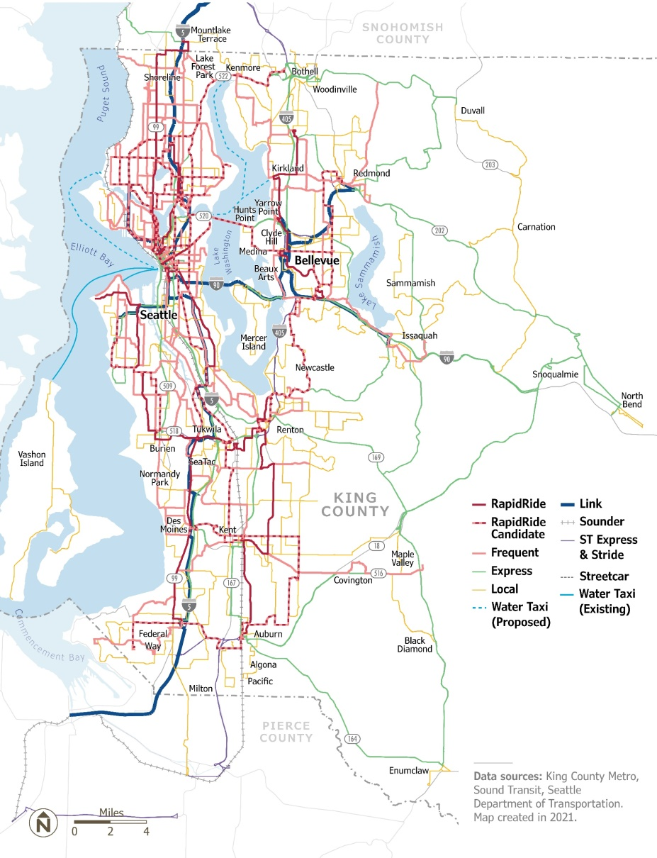
METRO CONNECTS FUTURE SERVICE NETWORKS
Interim Network
2050 Network

Slide 17
METRO CONNECTS FUNDING GAP
Metro Connects is unconstrained
Funding must be identified to achieve the long-range vision
 | Interim Network | 2050 Network
Annual Service Costs (Total) | $1.092 billion | $1.466 billion
Annual Service Costs (Funded) | $669 million | $742 million
% Service Costs Funded | 61.3% | 50.6%
Capital Costs YOE* $ (Total) | $11.5 billion | $28.3 billion
Capital Costs YOE $ (Funded) | $4.4 billion | $10.3 billion
% Capital Costs Funded | 38.2% | 36.4%
*YOE = Year of Expenditure

Slide 18
POTENTIAL 2024 WORK PLAN
ACTION | MONITORING | CONTEXT
RapidRide Prioritization Plan (due June 30) Performance measures dashboard annual report (due by November 30) 2024 System Evaluation report (due October 31) | RapidRide Prioritization progress Update on youth and ORCA LIFT fares | Metro’s community engagement processes Ridership recovery, service planning Metro’s vanpool program Electrification, zero-emission Metro operations Transit safety and security ADA Transition Plan

